Slide 1
Business Finance 101
Melissa Jordan Vice President | M&T Bank
Business & Professional Banking | Relationship Manager
(C) 585-734-7026 majordan@mtb.com | www.mtb.com
Business Education Portal | M&T Bank (mtb.com)

Slide 2
Managing Your Personal Credit
What every business owner should know
**This presentation is for educational purposes only

Slide 3
Overview
CREDIT SCORE
WHAT MAKES UP YOUR CREDIT SCORE
CREDIT SCORE FACTORS
HOW TO IMPROVE YOUR CREDIT SCORE
REVIEW

Slide 4
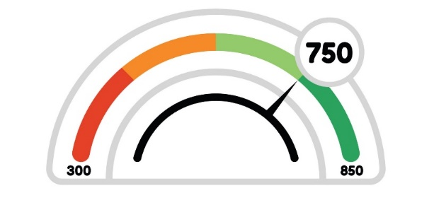
What is a Credit Score?
A credit score is a statistical number that evaluates a consumer's creditworthiness and is based on credit history.
Credit scores influence the credit that's available and the terms (interest rate, etc.) that lenders may offer. It is a vital part of credit health.
When you apply for credit - whether for a credit card, an auto loan, or a business loan - lenders want to know what risk they'd take by loaning money.
A credit score helps lenders evaluate a credit report by summarizing the credit risk at that point in time.
It is important to understand that not every credit score offered for sale online is a FICO® Score.
Source: https://www.myfico.com/credit-education/whats-in-your-credit-score

Slide 5
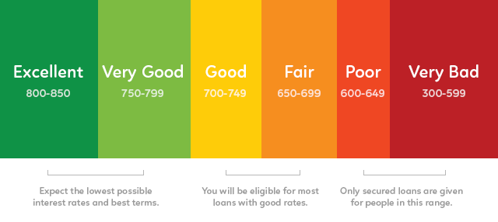
What is a FICO® Score?
The most widely used credit scores are FICO® Scores, the credit scores created by Fair Isaac Corp. FICO® Scores are calculated based solely on information in consumer credit reports maintained at the credit reporting agencies.
What is a good credit score?
Base FICO® Scores have a 300-850 score range. The higher the score, the lower the risk.
There is no single "cutoff score" used by all lenders and there are many additional factors that lenders use to determine your actual interest rates.
Source: https://www.myfico.com/credit-education/whats-in-your-credit-score

Slide 6
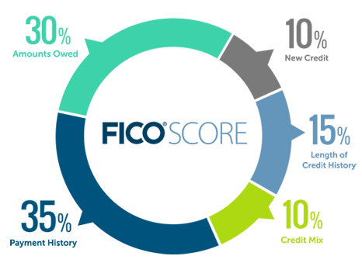
How are my FICO® Scores Calculated?
Source: https://www.myfico.com/credit-education/whats-in-your-credit-score

Slide 7
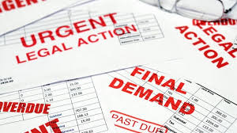
Public Record and Collection Items
Public record and collection items are considered quite serious, although older items and items with small amounts will count less than recent items or those with larger amounts.
Top 3 negative factors include:
Bankruptcies - will stay on your credit report for 7-10 years, depending on the type
Lawsuits
Wage attachments
Source: https://www.myfico.com/credit-education/whats-in-your-credit-score

Slide 8
Factors That Affect Your Score
The amount owed on all accounts
Note that even if you pay off your credit cards in full each month, your credit report may show a balance on those cards. The total balance on your last statement is generally the amount that will show in your credit report.
The amount owed on different types of accounts
In addition to the overall amount you owe, your FICO® Scores consider the amount you owe on specific types of accounts, such as credit cards and installment loans.
Credit utilization ratio on revolving accounts
Your credit utilization ratio on revolving accounts – the percentage of your available credit you're using – is an important factor in your FICO® Scores. Using a high percentage of your available credit means you're close to maxing out your credit cards, which can have a negative impact on your FICO Scores. On the other hand, using a low percentage of your available credit can have a positive impact. In some cases, a low credit utilization ratio will have a more positive impact on your FICO® Scores than not using any of your available credit at all.
Source: https://www.myfico.com/credit-education/whats-in-your-credit-score

Slide 9
Top 3 Tips to improve your FICO Score
Check credit report for errors
Carefully review your credit report from all three credit reporting agencies for any incorrect information. Dispute inaccurate or missing information by contacting the credit reporting agency and your lender.
Pay bills on time
Making payments on time to your lenders and creditors is one of the biggest contributing factors to your credit scores—making up 35% of a FICO Score calculation. Past problems like missed or late payments are not easily fixed.
Reduce the amount of debt you owe
Your credit utilization, or the balance of your debt to available credit, contributes 30% to a FICO Score's calculation. It can be easier to clean up than payment history, but it requires financial discipline and understanding the tips below.
Source: https://www.myfico.com/credit-education/improve-your-credit-score

Slide 10
Additional tips to reducing the amount of debt you owe
Reduce the amount of debt you owe
Your credit utilization, or the balance of your debt to available credit, contributes 30% to a FICO Score's calculation. It can be easier to clean up than payment history, but it requires financial discipline and understanding the tips below.
Keep balances low on credit cards and other revolving credit
Pay off debt rather than moving it around
Don't close unused credit cards as a short-term strategy to raise your scores
Don't open a number of new credit cards that you don't need
Source: https://www.myfico.com/credit-education/improve-your-credit-score

Slide 11
Summary
Amounts owed and payment history are important factors –pay on time!
Manage your credit utilization rate
Repairing credit takes time – no quick fix
As a small business owner your credit score tells the bank how you handle credit

Slide 12
Business Credit Basics
What every business owner should know
**This presentation is for educational purposes only

Slide 13
Overview
FINANCIAL STATEMENT REPORTING
INCOME STATEMENT
BALANCE SHEET
5 C’S OF CREDIT
REVIEW

Slide 14
Typical Financial Statement Reporting
Financial statements answer the questions:
How does this company make money?
What is this company worth?
Documents that tell the story for lenders include:
Income statement
Balance sheet
Statement of cash flows or profit and loss statement
Owners personal financial statement
Credit report(s)
Banks analyze 3 years of financial statements to look at trends
Notes:
There are six major drivers that tell the Bank if the business will be able to repay the loan and cover the owners personal expenses.

Slide 15
Income Statement
A summary of the business’s performance as reflected in the profitability (or lack of it) over a period of time. It itemizes the revenues and expenses of past results that lead to the current profit or loss.
Revenues
Income Statement
Expense
Profits
Source: http://www.businessdictionary.com/definition/income-statement.html
Notes:
Revenues: increasing, decreasing, projected – WHY?
Gross profit and net profit
How well is the business managing the expenses?
Owner distributions are a key consideration for a Bank.
Are the owners taking all the profit out of the company or are they leaving the profits in the company? There should be enough to pay for the debts incurred while running the business

Slide 16
Income Statement
Sample Business
1 | Revenues | 100,000
2 | Cost of goods sold | 60,000
3 (1-2) | Gross Profit | 40,000
 | Expenses
4 | Marketing & Adverting | 5,000
5 | General & Administrative | 20,000
6 | Other Operating Expenses | 5,000
7 (4+5+6) | Total Operating Expenses | 30,000
8 (3-7) | Operating Income | 10,000
 | Other Income (Expense)
9 | Net Interest Income | 1,000
10 | Net Interest Expense | (2,000)
11 | Income Taxes | (1,000)
12 (8+9-10-11) | Net Income | 8,000

Slide 17
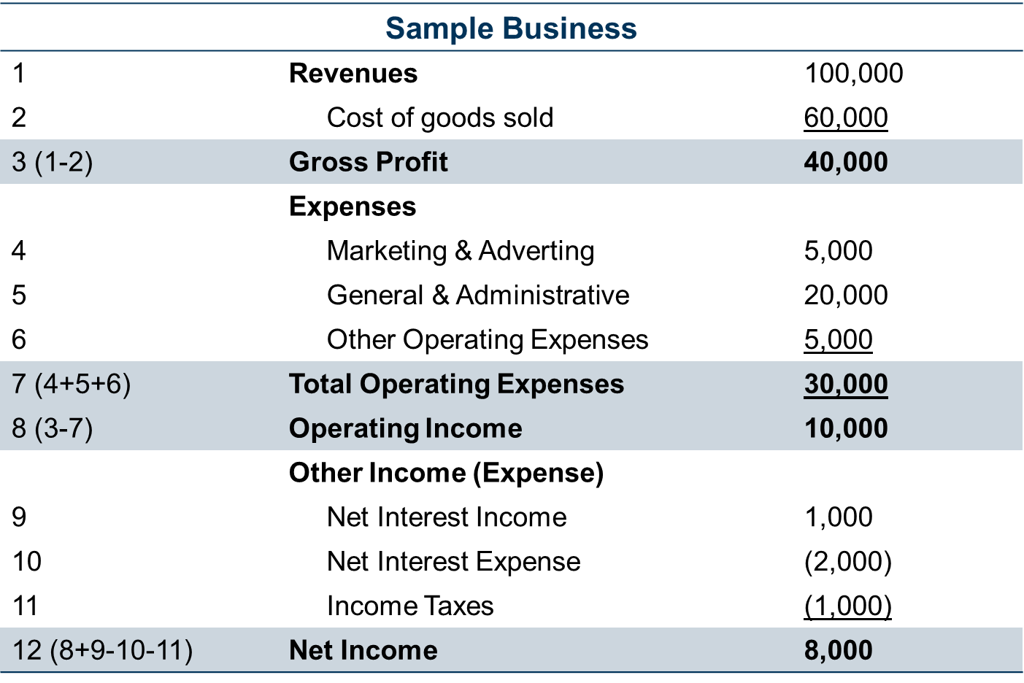
EBITA: Earning Before Interest, Taxes, Depreciation & Amortization
A method used in determining how profitable a company or business is with regard to operations.
Net Income | 8,000
+ Interest | 2,000
+ Taxes | 1,000
+ Depreciation | 0
+ Amortization | 0
=EBITA | 11,000
How much of a business loan can I afford?
Loan payments: $500/month or $6,000/year
EBITA /Loan Payment = 1.2
$11,000/$6,000 = 1.83X
Source: http://www.businessdictionary.com/definition/EBITDA-margin.html

Slide 18
Balance Sheet
A condensed statement that shows the financial position of an entity on a specified date.
Assets
$
Liabilities
Source: http://www.businessdictionary.com/definition/balance-sheet.html
Notes:
Liquidity- is there enough cash and receivables to pay liabilities
Equity- the difference between assets and liabilities (what you own)

Slide 19
Balance Sheet
Liabilities
 | Current Liabilities
1 | Accounts Payable | 3,000
2 | Notes Payable | 2,000
3 (1+2) | Total Current Liabilities | 5,000
 | Non-Current Liabilities
4 | Long Term Debt | 23,000
5 | Total Non-Current Liabilities | 23,000
6 (3+5) | Total Liabilities | 28,000
Assets
 | Current Assets
1 | Cash | 1,000
2 | Accounts Receivable | 5,000
3 | Inventory | 5,000
4 | Other Current Assets | 1,000
5 | Prepaid Expenses | 1,000
6 (1+2+3+4+5) | Total Current Assets | 13,000
 | Non-Current Assets
7 | Fixed Assets | 20,000
8 | Other Non Current Assets | 5,000
9 (7+8) | Total Non-Current Assets | 25,000
10 (6+9) | Total Assets | 38,000
Owner’s Equity
7 | Retained Earnings | 5,000
8 | Paid Capital | 5,000
9 (7+8) | Total Equity | 10,000
10 (6+9) | Total Liabilities & Owner’s Equity | 38,000
Notes:
Assets: Cash, marketable securities, real estate, autos, retirement accounts
Liabilities: Credit cards, auto loans mortgages
Equity: The difference between assets and liabilities

Slide 20
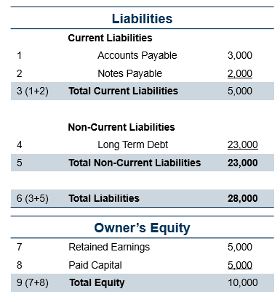
Debt to Equity Ratio
Measure of a firm’s leverage and its capacity for debt repayment.
Total Liabilities
Owner’s Equity
Debt to Equity Ratio
28,000
2.8
10,000
Source: http://www.businessdictionary.com/definition/debt-equity-ratio.html

Slide 21
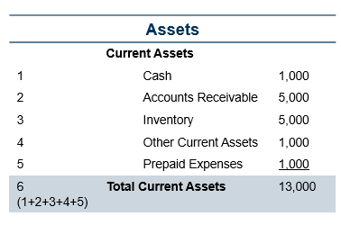
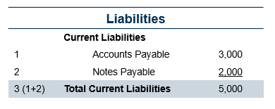
Current Ratio
Indicator of a firm’s ability to meet short-term financial obligations.
Current Assets
Current Liabilities
Current Ratio
13,000
2.6
5,000
Source: http://www.businessdictionary.com/definition/current-ratio.html

Slide 22
Statement of Cash Flow
Incomings and outgoings of cash, representing the operating activities of an organization.
Money Coming In
Money Going Out
Source: http://www.businessdictionary.com/definition/cash-flow.html

Slide 23
Understanding Business Cash Flow
A method used in determining how profitable a company or business is regarding operations.
Net Income or Changes in Total Net Assets | 26,000
+ Interest | 2,000
+ Depreciation | 1,000
+ Amortization | 0
=Cash Flow | 29,000
How much of a business loan can I afford?
Loan payments: $2,000/month or $24,000/year
Annual Cash Flow/Annual Total Loan Payments = Debt Service Coverage Ratio
29,000/$24,000 = 1.21X
Source: http://www.businessdictionary.com/definition/EBITDA-margin.html

Slide 24
5 C’s of Credit
The purpose of the loan
Market and economic conditions
The 5 C’s of Credit
Conditions
Capacity
Character
Collateral
Capital
Assets that act as security for the loan
Measures cash flow or the ability to repay the loan
Assesses borrower’s debt-to-income ratio
Borrower’s reputation or track record for paying debts
Cash borrower is willing to invest
Indicates the borrower’s level of seriousness

Slide 25
Small Business Loans
What every business owner should know
**This presentation is for educational purposes only

Slide 26
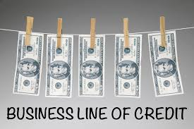
Types of Small Business Loans
Term loans – A lump sum with a fixed term and repayment amount.
Business lines of credit – Revolving line of credit with a maximum limit you can borrow.
Equipment loans – Fixed loan used to purchase and usually the equipment serves as collateral for the loan.

Slide 27
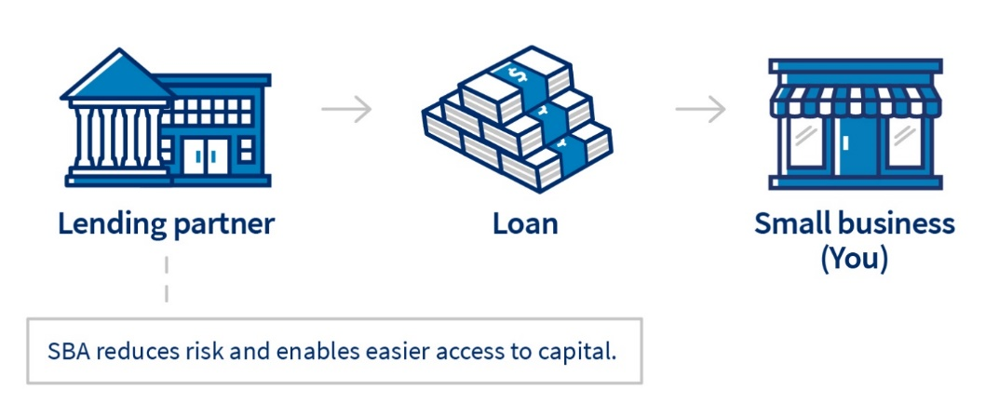
SBA- Small Business Administration
Is a government agency that offers support and resources to small businesses and offers guarantees for loans.
These SBA-backed loans were created by the SBA to help small businesses and startups, and are executed by commercial lenders who are approved by the SBA.
Source: https://www.sba.gov/funding-programs/loans

Slide 28
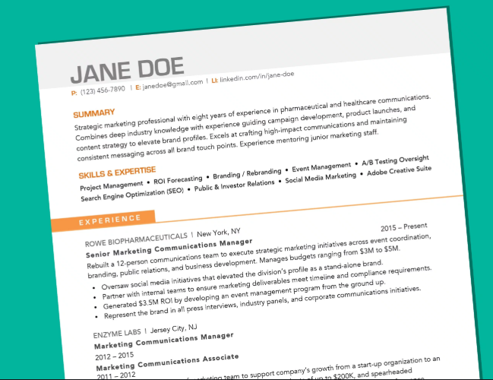
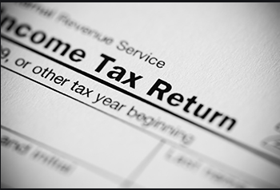
Documentation for the loan
Personal Background – You will need to provide personal information on the application.
Resumes – Beside submitting your resume, you will need to submit professional resumes of each principal.
Business Plan – All loan programs require a sound, detailed business plan. The business plan should include:
- Complete set of projected financial statements
- In-depth, five-year projected financial statement
- Cash flow and balance sheet
Income Tax Returns – Most lenders require applicants to submit personal and business income tax returns from the previous three years.

Slide 29
Legal Documents
Depending on your loan’s specific requirements, your lender may require you to submit one or more legal documents.
Make sure you have the following items ready, if applicable:
Business licenses and registrations
Business lease (either a copy of your current business lease or proposed lease from landlord)
Business formation document (articles of incorporation or LLC filing)
Copies of contracts you have with any third parties (subsidiaries and affiliates)
Franchise agreements

